Slide 2
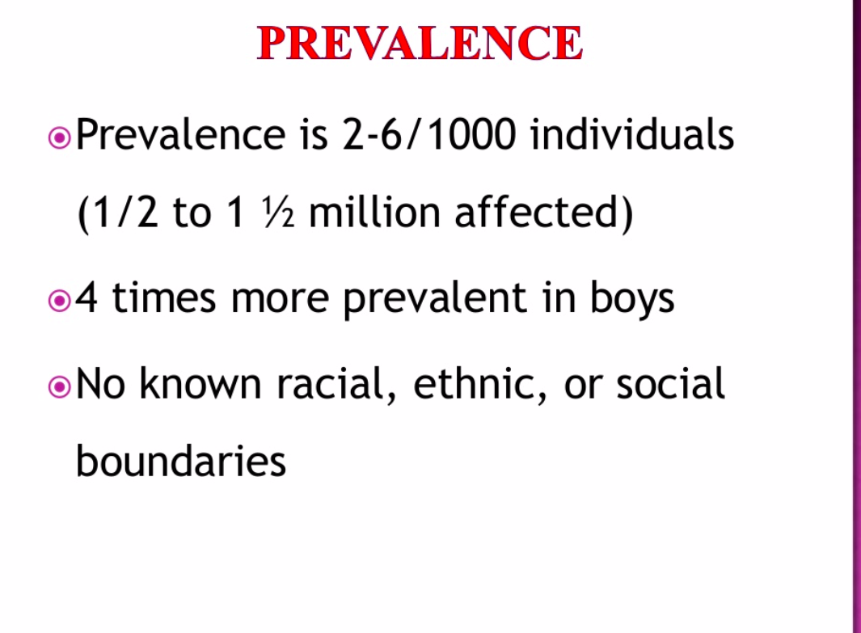

Slide 3
Learning Styles in ASD
Visual learner: think in pictures
Auditory learner : will respond better in listening tasks
Kinesthetic learner : learns through movement and touch
Semantic learner : learning by the underlying meaning of the stimulus (% on the spectrum is low in comparison to the rest)

Slide 4
The issue of Overselectivity
Stimulus over-selectivity is a term used to describe a phenomenon whereby a person focuses on only one aspect of an object or environment while ignoring other aspects. Many autistic individuals appear to have this 'tunnel vision.' This phenomenon was first described in 1971 by Lovaas, Schreibman, Koegel and Rehm at U.C.L.A.

Slide 5
Lovaas : Overselective Attention
Child may not hear the teacher’s voice but sees what the teacher is doing (ignoring the auditory cue)

Slide 6
Overselect within a stimulus dimension
Visual cues: shape, size, colour of a stimulus
(may pay attention to only one or two of these dimensions)
Auditory cues: loudness, pitch and form of verbal utterance
(may overselect and miss out on what is really being said

Slide 7
SELECTIVITY & FILTERING: APPLICATION
The parent think the child is deaf as the child ignores the banging sound of the door but comes nearby with the sound of opening a candy wrapper
The idea of responding to only one of many aspects or dimensions of an object may make it difficult for the autistic child to learn about his/her world. For example, if a child is being taught to differentiate between a fork and a spoon, the child may attend or focus on the color (a very salient aspect) rather than the shape. In this case, the child will experience much difficulty when trying to decide which utensil to use.

Slide 8
Why this tunnel vision?
Too much of concentration: difficult to expand and widen the attention span
Cannot process or attend to the environment as a whole: overwhelming, overarousal
Physiological basis: neurotransmitters, amygdala functioning
Thus, focusing on the small part of their world...

Slide 9
Strategy...
Discriminating task with multiple cues
Pick up the balls
Pick up the big balls
Pick up the big red balls...

Slide 10
Cohen & Johnson
Fixate inappropriately on apparently irrelevant stimuli based on highly specific areas of personal interest
EEG recordings: chronic state of overarousal resulting in rejection of sensory stimuli as a means of coping with the overload of information

Slide 11
Rimland
Individuals with ASD suffers from under-arousal
Actively prefer conditions that involve greater stimulations

Slide 12
Ritvo 1968
autism is “characterised by fluctuations between states of over and under-arousal resulting in a failure to modulate sensory intake adequately”.

Slide 13
Kinsbourne 1987
within the same child there can be both extremes; producing both over- and under-responsiveness across the sensory systems.

Slide 14
Current study
Arousal imbalance as a secondary outcome of the attention deficit

Slide 15
Sustained attention
Garretson, Fein and Waterhouse (1990)
may be linked to motivation
when faced with the subject of a particular interest, individuals with ASD may have enhanced capacity for sustained attention.

Slide 16
Orienting process
Disengaging
(may be due to obsessive patterns)
Shifting
Re-engaging

Slide 17
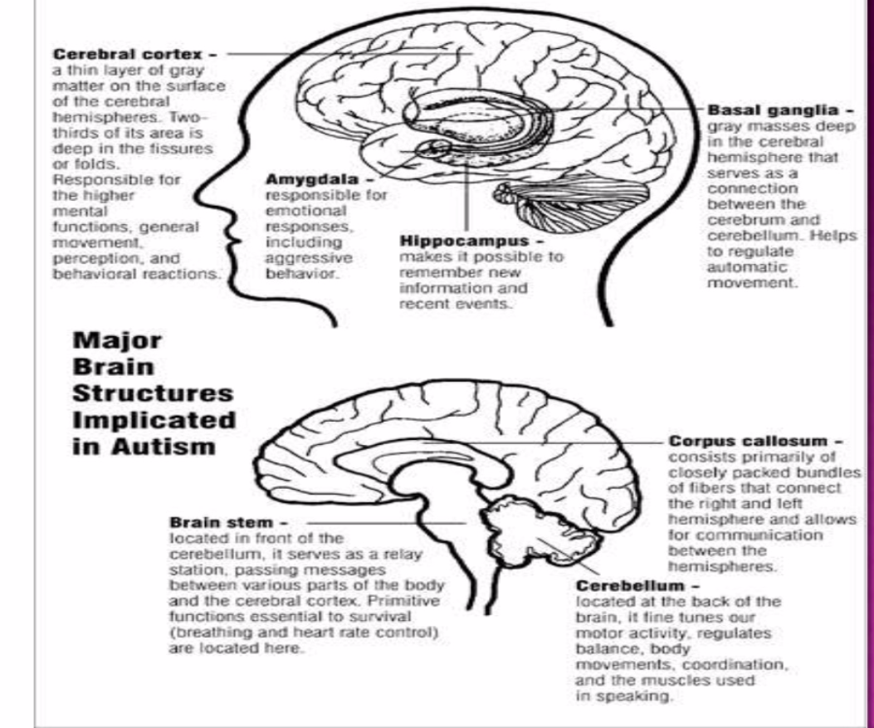

Slide 18
https://www.technologynetworks.com/neuroscience/news/key-social-reward-circuit-in-the-brain-impaired-in-kids-with-autism-306337
MRI scans revealed that kids with autism have differences in a brain pathway that normally makes social interaction feel rewarding. Nerve-fiber tracts along the pathway, in red, are less dense in children with autism than in typically developing children. Kaustubh Supekar, Stanford University
Notes:
https://www.technologynetworks.com/neuroscience/news/key-social-reward-circuit-in-the-brain-impaired-in-kids-with-autism-306337
MRI scans revealed that kids with autism have differences in a brain pathway that normally makes social interaction feel rewarding. Nerve-fiber tracts along the pathway, in red, are less dense in children with autism than in typically developing children. Kaustubh Supekar, Stanford University

Slide 19
https://www.spectrumnews.org/news/communication-brain-may-remarkably-constant-autism/
The researchers measured connectivity among three brain networks thought to be altered in autism: the default mode network, which plays a role in self-reflection; the salience network, which directs attention; and the central executive network, which governs decision-making and other cognitive tasks.
In controls, from early to late adolescence, connectivity increases significantly between the central executive and default mode networks. And as activity increases in one, it decreases in the other. This shift suggests that the networks become more specialized, performing distinct functions.
In the autism group, however, connectivity in these networks remains stable and does not appear to specialize
Notes:
https://www.spectrumnews.org/news/communication-brain-may-remarkably-constant-autism/
The researchers measured connectivity among three brain networks thought to be altered in autism: the default mode network, which plays a role in self-reflection; the salience network, which directs attention; and the central executive network, which governs decision-making and other cognitive tasks.
In controls, from early to late adolescence, connectivity increases significantly between the central executive and default mode networks. And as activity increases in one, it decreases in the other. This shift suggests that the networks become more specialized, performing distinct functions.
In the autism group, however, connectivity in these networks remains stable and does not appear to specialize

Slide 20
Language difficulties
idioms (e.g., save your breath, jump the gun, second thoughts);
double meanings (most jokes have double meanings);
sarcasm (e.g., saying, "Great!" after he has just spilled a bottle of ketchup on the table);
nicknames

Slide 21
Slide refence: UNIQUE LEARNING STYLES
ON THE SPECTRUM, arpita bhattacharya, pradip centre for autism management

Slide 22
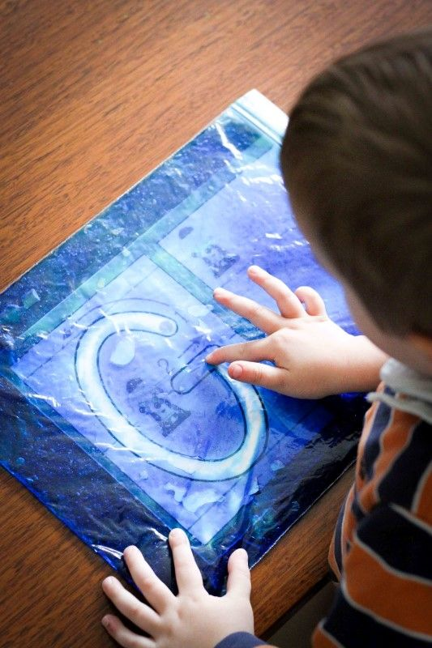

Slide 23
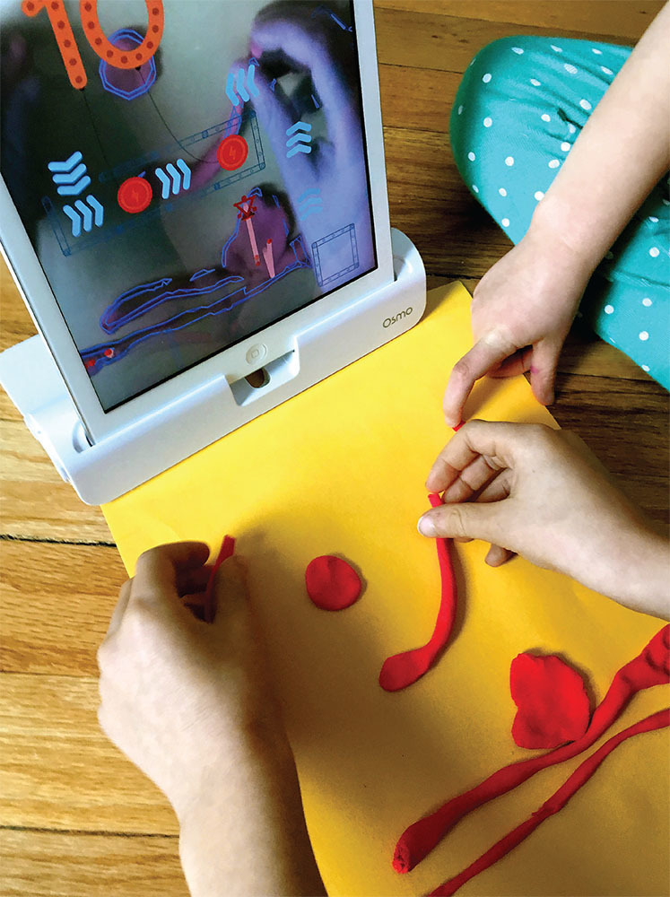

Slide 24
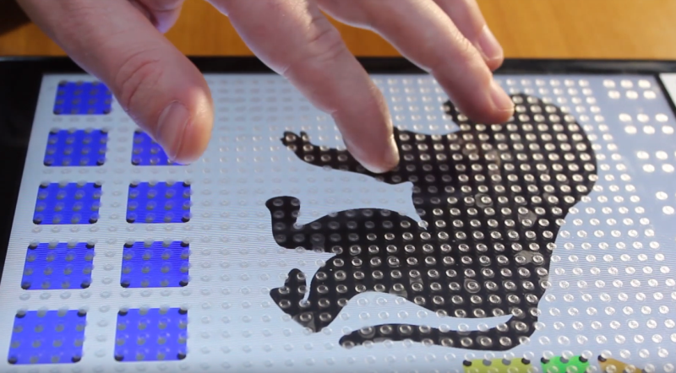

Slide 25


Slide 26
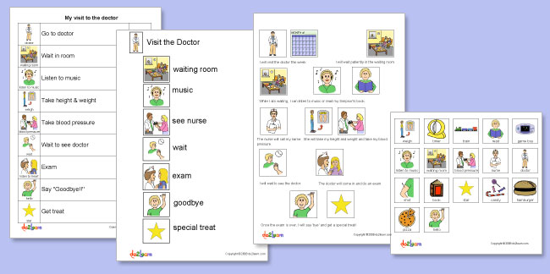
Picture Exchange Communication System (PECS)

Slide 27
